Slide 1
Techniques for estimation
We measure
  Size
  Effort
  Cost

Slide 2
Techniques for estimation
Function point based
LOC based
COCOMO

Slide 3
We measure to
To indicate the quality of the product
To assess the productivity of the people who produce the product
To assess the benefits derived from new software engineering methods and tools
To form a baseline for estimation
To help justify requests for new tools or additional training

Slide 4
The Challenge of Metrics
A comprehensive measure of software complexity is an impossible goal
Consider a measure for evaluating an attractive car

Slide 5
Important Concepts
Measure (noun or verb)
  a quantitative indication of an attribute of a product or process; like capacity, size, quality
  Examples: errors, quality of software, correctness
Metrics
  Quantitative measure of the degree to posses a given attribute
  Examples, Number of errors, errors per person
Measurement
  The act of measuring

Slide 6
Metrics Guidelines
Use common sense and organizational sensitivity when interpreting metrics data
Provide regular feedback to the individuals and teams who have worked to collect measures and metrics
Don’t use metrics to appraise individuals
Never use metrics to threaten individuals or teams
Don’t obsess on a single metric to the exclusion of other important metrics

Slide 7
Types of Metrics
In direct measures
  Quality, functionality, complexity, reliability, efficiency, maintainability, …
Direct measures
  Lines of codes (LOC), speed, cost, memory size, errors, ...

Slide 8
Techniques
Function point estimation
LOC based estimation
COCOMO

Slide 9
Function point based metrics
Function-based metrics
  Can be used effectively as a means for measuring the functionality delivered by the system

Slide 10
Function point based metrics
Function-based metrics
  Can be used effectively as a means for measuring the functionality delivered by the system
  Using historical data, FP metric can be used to
    Estimate the cost or effort required to design, code and test software
    Predict the number of errors that will be encountered during testing
    Forecasting the number of components /or number of projected source lines

Slide 11
Function point based metrics
Function-based metrics
  Number of external inputs (EIs)
    Originate from user or from another application
  Number of external outputs (EOs)
    Derived data in application like reports, screens, errors
  Number of external inquiries (EQs)
    An input that results in immediate software response
  Number of internal logical files (ILFs)
    Logical grouping of data
  Number of external interface Files (ELFs)
    Logical grouping of data that resides external to software

Slide 12
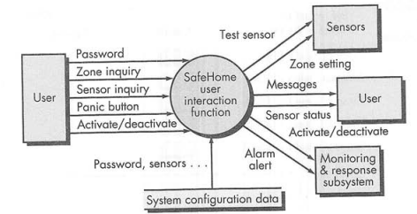
Example

Slide 13
Example
External inputs = password, panic button and active/deactivate
External Inquiry = zone inquiry, and sensor inquiry
Internal logical files = system configuration file
Two external outputs = message and sensor status
External interface files = test sensor, zone setting, active/deactivate, and alarm alert

Slide 14
Computing Function Points
Analyze information
domain of the
Establish
count
for input domain and
application
system interfaces
and develop counts
Weight each count by
Assign level of complexity or
weight
assessing complexity
to each count
Assess influence of
Grade significance of external factors, F
global factors that affect
i
such as reuse, concurrency, OS, ...
the application
Compute
function points
FP = Count Total * [ 0.65 + 0.01 * (Fi)]

Slide 15
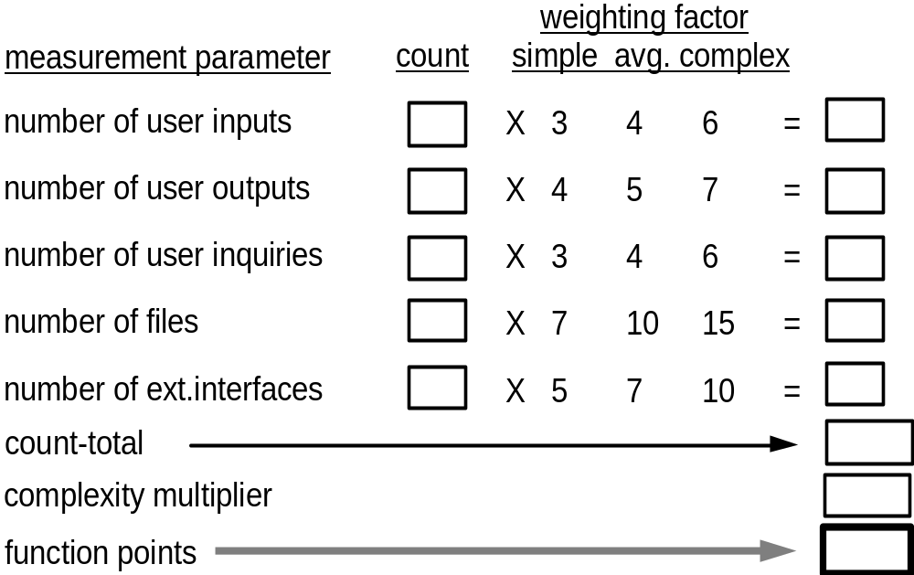
Analyzing the Information Domain & weight

Slide 16
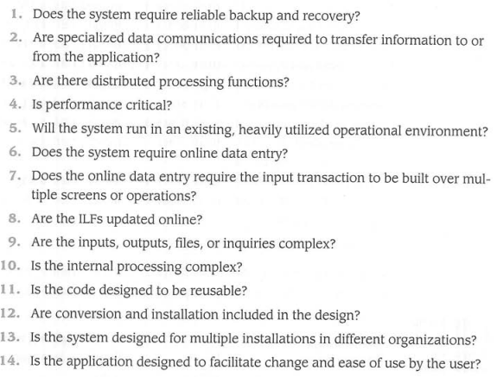
Global factors
Factors are rated on an answering scale 0 (not important)-5 (very important)

Slide 17
Global factors
For each complexity adjustment factor (F), give a rating on a scale of 0 to 5
  0 - No influence
  1 - Incidental
  2 - Moderate
  3 - Average
  4 - Significant
  5 - Essential

Slide 18
FP = Count Total * [ 0.65 + 0.01 * Σ(Fi) ]
WHY OPT for FP MEASURES
Independent of programming language
Does not “penalize” inventive implementations that require fewer LOC than others

Slide 19
Example
Analyze information
domain of the
application
and develop counts
Weight each count by
External inputs = password, panic button and active/deactivate
assessing complexity
External Inquiry = zone inquiry, and sensor inquiry
Assess influence of
Internal logical files = system configuration file
global factors that affect
Two external outputs = message and sensor status
the application
External interface files = test sensor, zone setting, active/deactivate, and alarm alert
Compute
function points

Slide 20
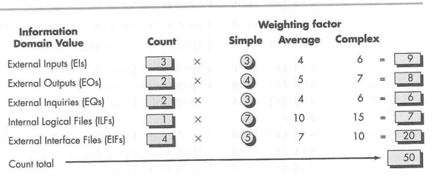
Example
Analyze information
domain of the
application
and develop counts
Weight each count by
assessing complexity
Assess influence of
global factors that affect
the application
Compute
function points

